Slide 1
10th Grade Top State For Talent
School Counseling Lesson
Sprayberry High School
School Counseling Department

Slide 2
CCSD School Counseling
Student Standards
C.1 Explore career options based on personal values, abilities, and interests.
C.3 Develop the ability to balance academic, extracurricular, and personal responsibilities, recognizing the importance of maintaining well-being and managing time effectively.

Slide 3

Today’s Learning Targets
I can interpret my high school transcript to identify grades, credits earned, GPA, and progress toward graduation.
I can describe key components of postsecondary preparation, including meeting graduation requirements, completing college entrance (SAT/ACT), and exploring post-graduation pathways.
I can identify my top three emerging talents to build resilience, confidence, and productivity in school and life through the Brain Flex assessment.
I can complete the Dual Enrollment (DE) survey to demonstrate understanding of the DE process and express interest in participating in college-level coursework.

Slide 4



Sprayberry High School
School Counseling Department
Dr. Beshears– A - D – lea.beshears@cobbk12.org
Mrs. Hawk– E - L – misty.hawk@cobbk12.org
Ms. Jordan– M - Ri – crystal.Jordan@cobbk12.org
Dr. White– Ro - Z – tammy.white@cobbk12.org
Notes:
Add each school counselor’s name and alpha.

Slide 5
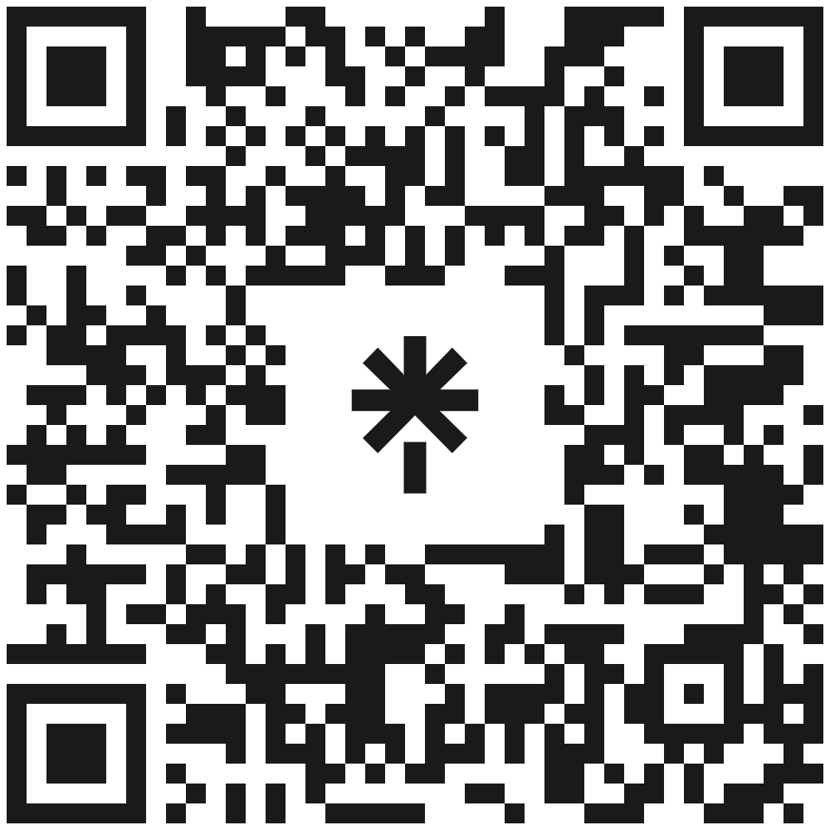



Stay Connected
www.sprayberrycounseling.com
@Sprayberrycounseling
@SHScounse1ing
http://www.youtube.com/@sprayberrycounseling​

Slide 6
Reasons To See Your Counselor
Academic
Personal
College & Career

Slide 7
How To Contact Your School Counselor
Students can schedule an appointment with their counselor in SchoolLinks
  Click My Team and schedule an appointment with your counselor
All counselor emails can be found in this presentation or on sprayberrycounseling.com
Notes:
Explain how to make an appointment with a counselor and add email addresses as well as any links to an online program that your department is using (such as, youcanbookme.com)

Slide 8
Things to Know
Confidentiality
What you share with your school counselor stays private, unless it involves safety concerns or someone (including yourself) being in danger.
Safety
If you are concerned about a friend/classmate, notify a school counselor or trusted adult immediately.
Examples include suicide, drugs, alcohol, abuse, etc.

Slide 9

Today’s Agenda
Graduation Requirements
Reading Your Transcript
GAfutures
Dual Enrollment
Testing
SchooLinks
Notes:
This is our agenda for today’s lesson.

Slide 10
Graduation Requirements

Slide 11
Graduation Requirements
Subject Area | Required Credits
English/Language Arts | 4 credits (Lit I, Lit II, 3rd & 4th ELA)
Mathematics | 4 credits (Alg I, Geom, Adv Alg, and 4th math)
Science | 4 credits (Biology, Physics/Physical Science, Chem/Earth Sci/Env Sci, 4th science)
Social Studies | 3 credits (World History, U.S. History, Gov/Econ)
World Language/CTAE/Fine Art | 3 credits
Personal Fitness | 0.5 credit
Health | 0.5 credit
General Electives | 4 credits
TOTAL CREDITS: | 23
Notes:
Discuss the new ELA requirements
- Literature & Composition I
Literature & Composition II
Literature & Composition III
Literature & Composition IV
Literature & Composition I is the first course in the sequence for ELA courses required for graduation.
Also discuss that three (3) units of JROTC are equivalent to the Health/PF requirement.
Refer to Administrative Rule IHF-R for detailed promotion requirements.

Slide 12
Promotion Requirements
Grade Level | Required Credits
10th | 5 credits (1 credit each in core English, Math and Science)
11th | 10 credits (2 credits each in core English, Math, and Science)
12th | 16 credits (on track for graduation)
Notes:
You can refer to Board Policy: IHE-R, if needed.

Slide 13
GAfutures

Slide 14
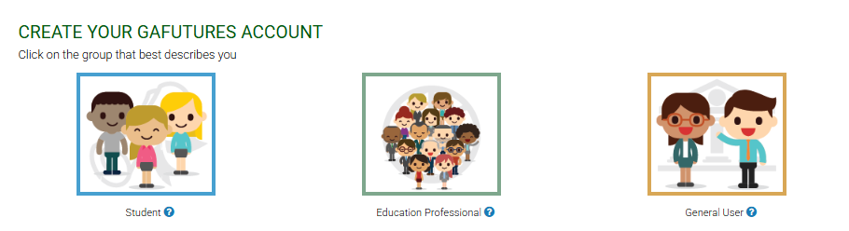
Creating Your GAfutures Account
Step 1 – Go to GAfutures.org
Step 2 – Click Create an Account at the top
Step 3 – Select the ‘Student Account’ option

Slide 15
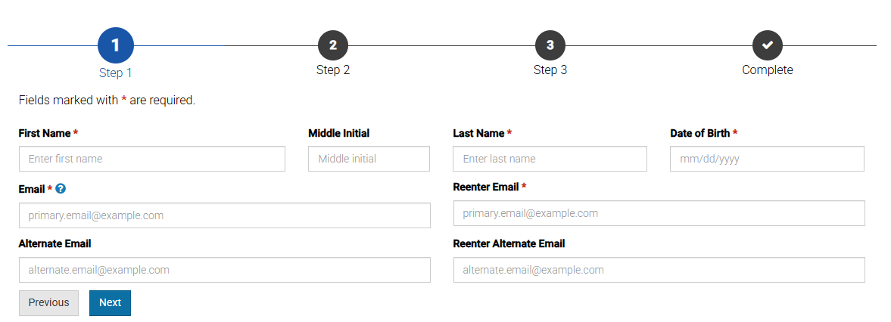
Creating Your GAfutures Account
Step 4 – Enter your information
  This information must be as it is listed on your transcript/records
  Only sections with a red star are required

Slide 16
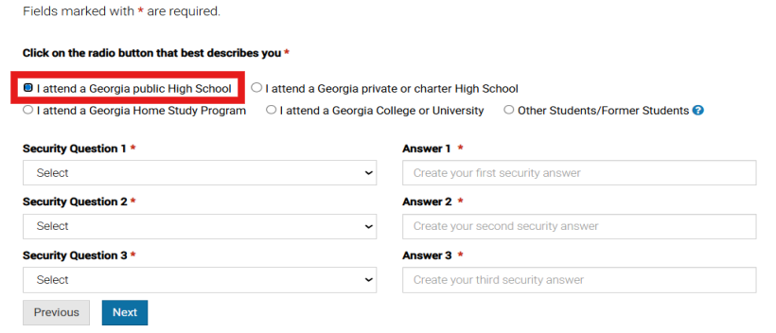
Creating Your GAfutures Account
Step 5 – Select your ‘High School’ type
  You must also select security questions and answers accurately.

Slide 17
Understanding Georgia’s
HOPE Programs

Slide 18
The HOPE Scholarship
HOPE stands for Helping Outstanding Pupils Educationally.
These scholarships are awarded to Georgia residents who meet specific academic achievement criteria. They help cover costs at eligible colleges and universities in Georgia. While each scholarship has different criteria, they can be a great way to help pay for college.
Be a U.S. citizen or meet eligible non-citizen requirements.
Must have your SSN updated in the CCSD student record.
Be a Georgia resident for at least one year.
Be in compliance with Selective Service registration requirements.
Must have a minimum of a 3.0 HOPE GPA upon graduation.
Must pass 4 rigor classes from GSFC’s Academic Rigor Course List.
New HOPE GPA Change
  Specific Advanced Fine Arts courses will be included
  New calculation will be effective with the Class of 2027
To see your HOPE GPA, visit GAfutures.org
Notes:
The GSFC Academic Rigor Course List was updated as of September 2025 (which is the most current).

Slide 19
The HOPE Grant
HOPE Grants are available to Georgia residents who are working towards a certificate or diploma at an eligible college or university in Georgia.
Available at any TCSG college in Georgia
Eligibility requirements vary for each grant
Can significantly reduce the cost of post-secondary education
Great opportunity to make college more affordable and accessible
Notes:
Talking Points:
- Remind students that the HOPE Grant is a separate program from the HOPE scholarship.

Slide 20
HOPE Career Grant
Be a Georgia resident
Must be a recipient of the HOPE or Zell Miller Grant
Eligible for students working towards a certificate or diploma at a technical college in programs that are considered high-demand career fields
Fixed award amount based on program and number of enrollment hours
To learn more, visit GAfutures: HOPE Career Grant

Slide 21
Zell Miller Scholarship
Be a U.S. citizen or meet eligible non-citizen requirements
Be a Georgia resident for at least one year
Must graduate from a Georgia high school
Be in compliance with Selective Service registration requirements
Must pass 4 rigor classes from GSFC’s Academic Rigor Course List
Must have a minimum of a 3.7 HOPE GPA upon graduation
1200 SAT (Math and Reading) or 25 ACT (Composite)
Must have your SSN updated in the CCSD student record.
Covers full tuition!
To see your HOPE GPA, visit GAfutures.org
Notes:
The GSFC Academic Rigor Course List was updated as of September 2025 (which is the most current).

Slide 22
Zell Miller Grant
Be a U.S. citizen or meet eligible non-citizen requirements
Be a Georgia resident for at least one year
No GPA requirement
No test score requirement
Must earn a 3.5 GPA at the end of each term at the postsecondary institution
Eligible for students working towards a certificate or diploma at a technical college
Covers standard tuition rate!
To see your HOPE GPA, visit GAfutures.org
Notes:
The GSFC Academic Rigor Course List was updated as of September 2025 (which is the most current).

Slide 23
What are Academic Rigor Courses?
Some graduation requirements qualify as rigor courses for HOPE and Zell.
As you register for 11th- and 12th-grade courses, keep the following in mind. Examples of rigor courses include:
  Math (e.g., Advanced Algebra, PreCalc, AFA)
  Science (e.g., Physics, Chemistry, Zoology, Computer Sci Principles)
  AP classes
  DE classes
  World Languages (Level 2 and higher)
Remember, students must pass 4 rigor classes from GSFC’s Academic Rigor Course List.

Slide 24
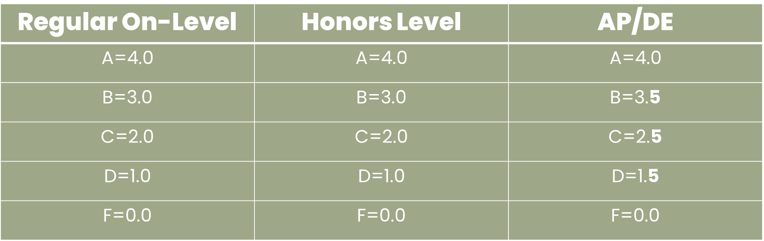
Understanding Your HOPE GPA
Your HOPE GPA = the average of your core classes (English, Math, Science, Social Studies, World Language, and some electives)
Some AP and DE classes earn extra quality points up to a 4.0

Slide 25
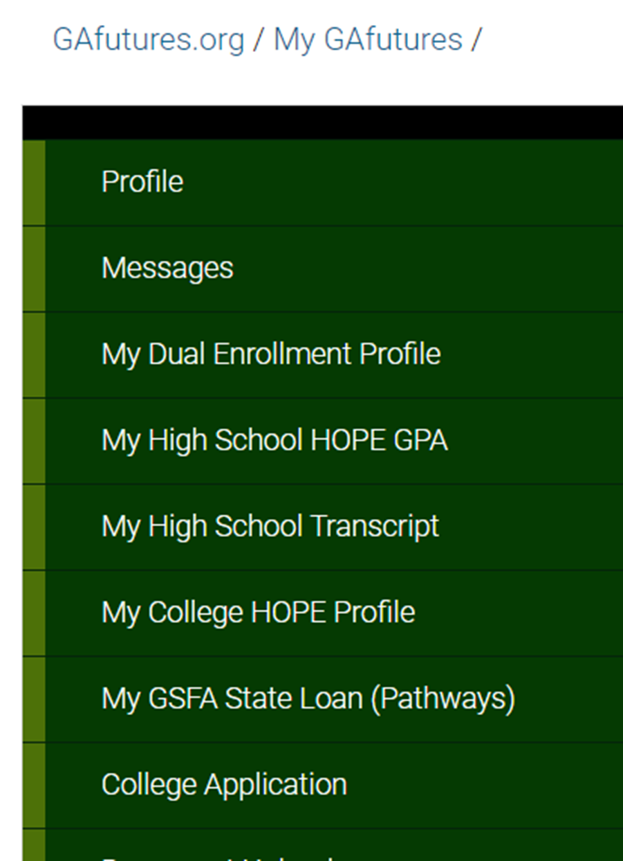
Accessing Your HOPE GPA
To access your HOPE GPA, log in to your GAfutures account at GAfutures.org.
On your homepage, click “My High School HOPE GPA” on the menu bar.
Reminder: To view your High School HOPE GPA, we must have your Social Security number on file at school.

Slide 26
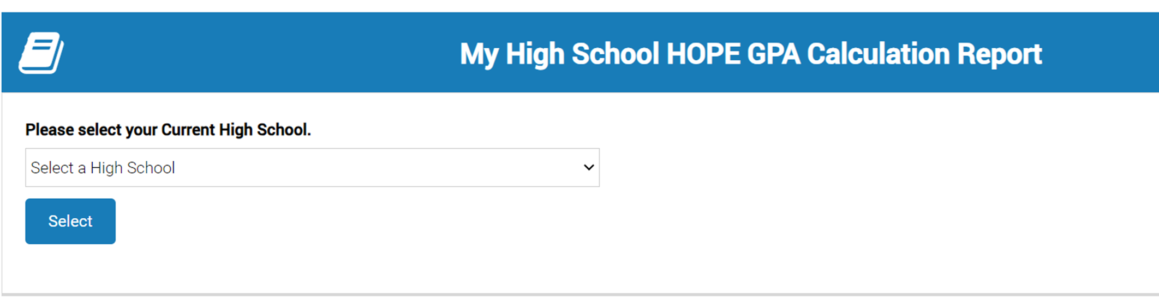

Accessing Your HOPE GPA
Select the high school you are currently attending
Click “View Your Detailed GPA Report” to view your HOPE GPA and access your HOPE transcript

Slide 27
Testing
Notes:
The SAT and ACT are standardized tests that colleges use to determine how prepared you are to take college-level courses. Depending on the institution and your high school GPA, the college/university might require these tests for admissions. The SAT and ACT can also open the door for scholarships!

Slide 28
PSAT & SAT
PSAT- October 21
The state of Georgia pays for all 10th grade students to take the PSAT.
This test is designed to prepare students for the SAT.
College Board offers free, online practice tests.
To access your PSAT scores, visit The PSAT/NMSQT – SAT Suite | College Board.
SAT
This assessment contains 2 sections in a digital format.
  Reading & Writing
  Math
Be mindful of application deadlines when completing your registration.
College Board offers free, online practice tests.
Register online at The SAT – SAT Suite | College Board

Slide 29
PRE-ACT & ACT
Pre-ACT
Some high schools may offer the Pre-ACT to their students.
The purpose is to give students a preview of the ACT, allowing them to practice and plan for their future ACT scores.
This test is designed to prepare students for the ACT.
The official ACT website offers free, online practice tests and daily practice questions.
To access the online practice tests, visit Free Practice ACT Test | ACT.
ACT
This assessment includes 5 sections.
  3 Required: English, Math, and Reading
  2 Optional: Science and Writing
It is multiple-choice, timed, and no penalty for wrong answers.
Be mindful of application deadlines when completing your registration.
The official ACT website offers free, online practice tests and daily practice questions.
Register online at The ACT - Register for the ACT.

Slide 30
The ASVAB
The Armed Services Vocational Aptitude Battery (ASVAB) is an exam that measures developed abilities and helps predict future academic and occupational success in the military.
The ASVAB is available to all students and helps with career exploration by identifying careers that match your strengths, even outside the military.
For more information, contact your school counselor.
Notes:
Talking Points:
The Armed Services Vocational Aptitude Battery (ASVAB) is an exam that measures developed abilities and helps predict future academic and occupational success in the military. This exam is available to all students who seek information about their skill set.
Note: If your school is offering the ASVAB and it has been scheduled, this would be a great opportunity to share the information with students. You could include the information in this slide.

Slide 31
Dual Enrollment

Slide 32
Dual Enrollment
DE: State-funded program for 11th and 12th graders to take college courses while earning a HS diploma
10th Grade Options: Limited DE opportunities available
  Any 10th grader can take CTAE classes at a technical college
  10th graders who earned a 1200 SAT or 26 ACT (in one sitting) are eligible to apply to participating DE programs.
Costs Covered: 100% tuition, mandatory fees, and required textbooks up to a maximum cap of 30 credit hours
Next Steps: Schedule an appointment with your assigned school counselor
Notes:
You may refer to Board Policy: IDCH-R, if needed.
Each school can edit the 4th bullet to add their school-specific next steps for interested students (i.e., talk to your school counselor, attend information session, etc.)
Here is a list of benefits of DE that you can present to your students as appropriate:
Introduces students to college-level coursework.
• Earning college credits while still in high school may enable students to graduate early and/or possibly even earn an associate degree, diploma or certificate.
• Helps students adjust to certain aspects of the college experience (e.g., classes, coursework, and instruction, being on a college campus) so the transition from high school to college may be easier.
• Students who participate in a dual enrollment program are more likely to go to college and get a college degree.
• Students may be able to take classes that are not offered at their high school, especially in subject areas they are interested in for a potential career.
• Participating in a dual enrollment program demonstrates a student’s ability to handle more difficult coursework which is something college admissions officers may look upon favorably during admissions and recruiting.
• Taking college-level classes while still in high school may build confidence and encourage those students who may not be thinking about college to reconsider.

Slide 33
DE Considerations
Will your college of interest accept your DE credits?
DE vs. AP
Full-time vs. Part-time participation
Transportation to the college
Scheduling conflicts
In-school and extracurricular responsibilities
CCSD and the college’s calendars may be different (e.g., breaks, exam dates)
Notes:
Talking Points:
Discuss your school’s DE processes and procedures to ensure students understand the required steps. If your school has an upcoming required DE information session, this would be an opportunity to share with your students.

Slide 34


Slide 35
SchooLinks
SchooLinks is a delivery system and a college/career readiness platform that helps students explore their interests, discover career pathways, and plan for life after high school.
We will use it to communicate with you and to coordinate various activities throughout the year.
You can access SchooLinks from the CCSD homepage or your school’s website.
Notes:
Talking Points:
-Explain that SchooLinks is our new college and career platform.
-You can use SchooLinks for college and career planning, communicating with your school counselor, scholarship searches, resume building, and tracking your post-secondary goals.
If you choose, you can include graphics of where on the website(s) the icons are.

Slide 36


Accessing SchooLinks
Go to Clever
Look under “More Apps” for SchooLinks
Notes:
Accessing SchooLinks
Go to Clever
Look under “More Apps” for SchooLinks

Slide 37
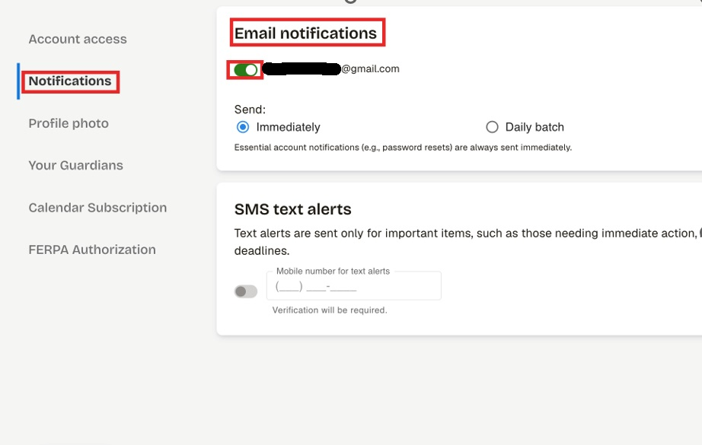
Adding Your Email Address
On your homepage, click on the gear icon (top-right corner)
Select “Account Settings”
Click “Edit Notifications” under “Login Methods”
Click “Add/Edit Email”
Enter your personal email address (not your students.cobbk12.org)
Press “Save”
Next, click on Notifications to make sure it is turned ON for your personal email address.

Slide 38
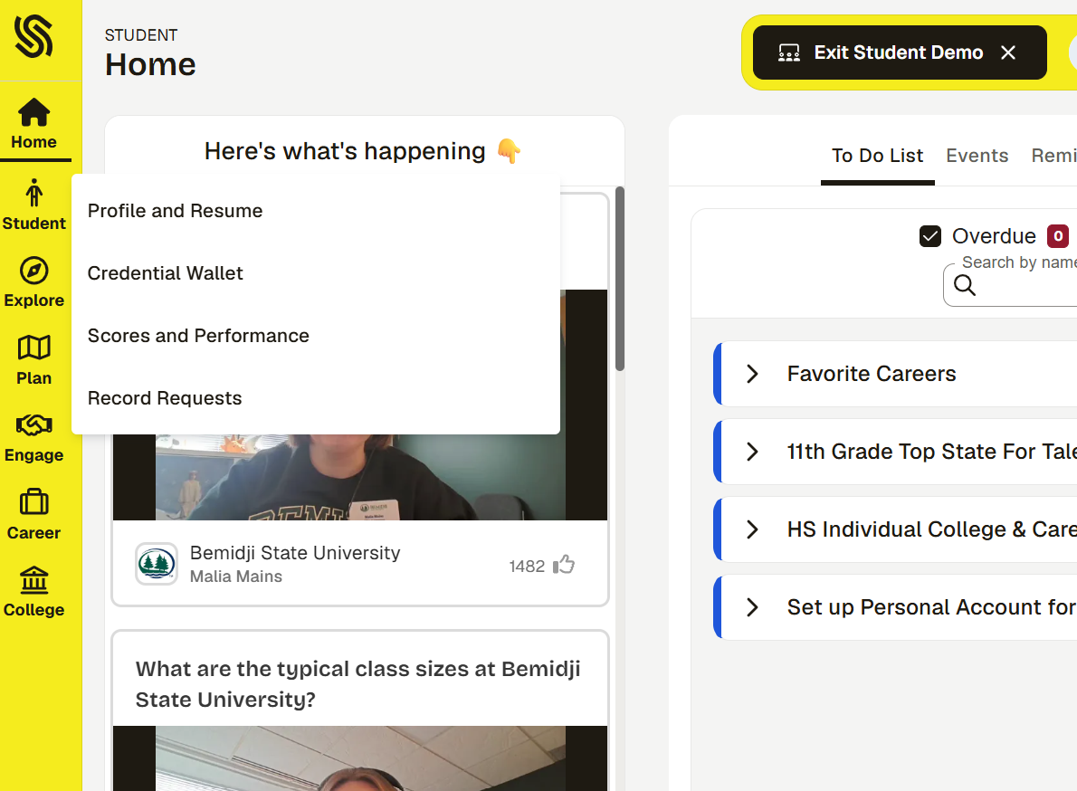
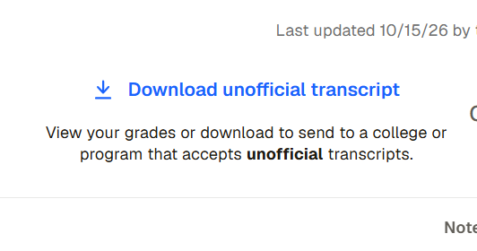
Locating Your Transcript

Slide 39
Information Listed On The Transcript
Personal Information
  Full name, DOB, address, student ID (lunch number)
Attendance (per school year)
Cumulative GPA
  Weighted
  Unweighted
  Note: Grades for all HS courses taken.
Credits attempted and earned
EOC scores

Slide 40
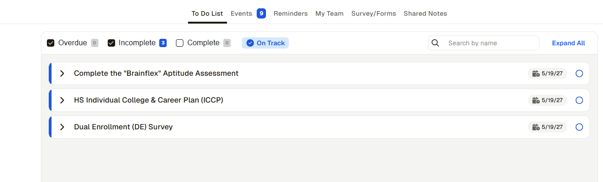
Locating Assessments To Complete
On your homepage, you will see the tasks to complete under the To Do List.
There are three tasks to complete:
  Brain Flex Aptitude Assessment
  ICCP
  Dual Enrollment (DE) Survey
Notes:
Talking Points:
The “Brain Flex” assessment helps you learn how your brain works and how you process information. It gives you insight into your strengths and learning style so you can study smarter and make better decisions about your future.
It helps you understand how you learn best, so you can study more effectively and be more successful in your classes. It also helps you make better choices about classes you plan to take for the upcoming school year, careers you may be interested in, and future plans based on your strengths.

Slide 41
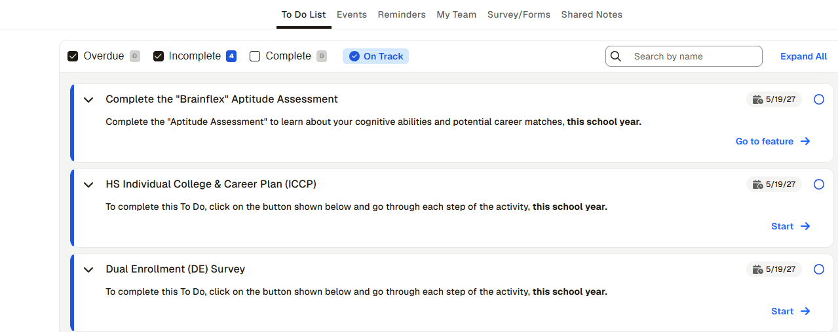

Slide 42
10th Grade Dual Enrollment (DE) Survey
On your homepage, you will see the tasks to complete under the To Do List.
Select "Dual Enrollment (DE) Survey"
Answer the question.
Click Save and Finish.

Slide 43
Individual College and Career Plan
On your homepage, you will see the tasks to complete under the To Do List.
Select “Individual College and Career Plan“
Click the link to visit the page.
Click Done.

Slide 44
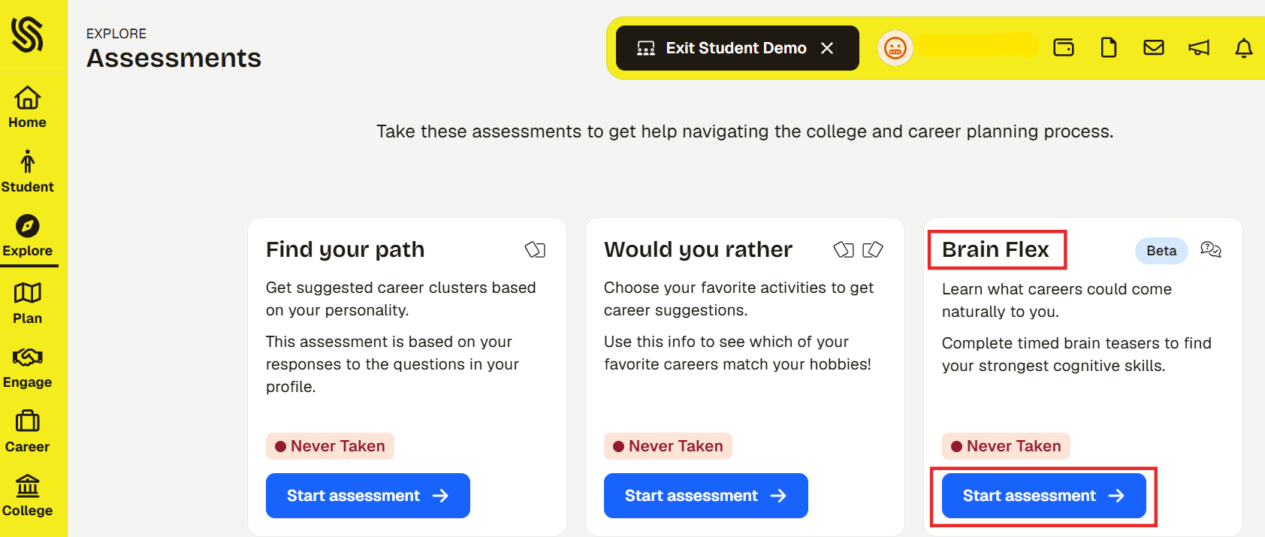

Slide 45
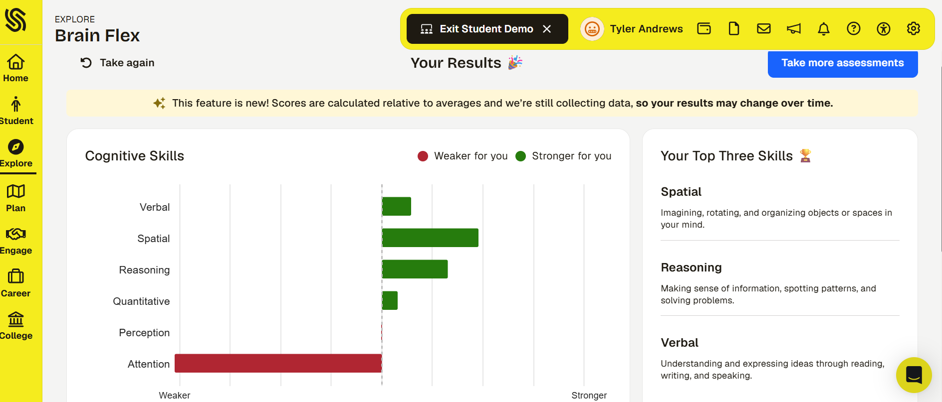
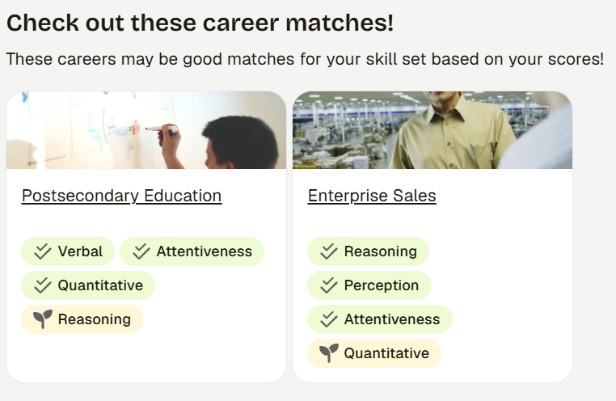
Review Your Results
Notes:
Talking Points:
The screenshot above is just an example.
After you take the assessment, take time to explore your matches, this is a starting point to help you think about your future, not a final decision.
You can open your results to see your top interest areas, matching career paths, and suggested careers. You can click on any career match to learn more about the job description, required education, the salary. And, you can save (or favorite) it to your list. Remember, you need to save at least 3 careers!

Slide 46
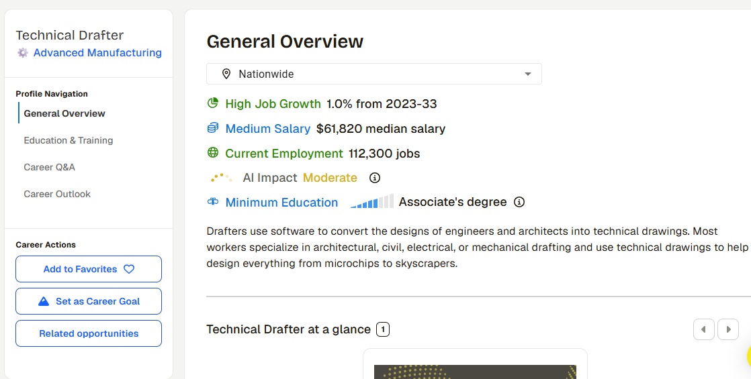
Exploring Careers
More information in each of these tabs
Interesting information
Scroll for even more information!
Notes:
Use this slide if you want to help show where they can find information.
The tabs on the left take them to information about education and training including what majors are needed (and then what colleges offer those majors) as well as outlook for the future of that career
In the middle is interesting information ranking this career among others. The words in color show how it ranks – High, Medium, or low compared to other careers
There is a video for each career and then they can scroll for even more information!

Slide 47
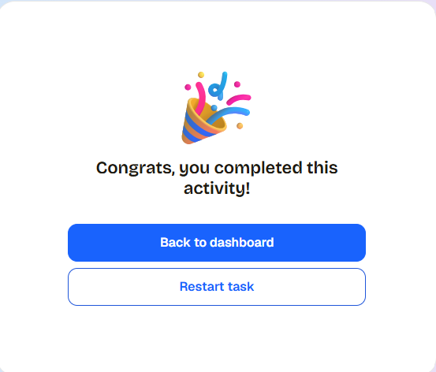
Wait, Do Not Log Out!
Make sure a counselor has verified that all tasks have been completed.

