Slide 1
Anxiety/Stress Coping Skills Part 2 By: Dr. Renea Oseni

Slide 2
RETURN TO CALM
Anxiety and stress are normal emotions that people experience at some point in their lives.
Too much anxiety or stress can get in the way of living a healthy and happy life.

Slide 3
EXERCISES FOR ANXIETY/STRESS
Relax by Breathing
Relax by Visualizing
Relax Your Muscles
Relax by Staying Present
Relax by Counting
Relax by Interrupting Your Anxious Thinking

Slide 4
RELAX BY BREATHING
Sit
Sit in a quiet and comfortable place. Put one of your hands on your chest and the other on you stomach. Your stomach should move more than your chest when you breathe in deeply.
Take In
Take a slow and regular breath in through your nose. Watch and sense your hands as you breathe in. The hand on your chest should remain still while the hand on your stomach will move slightly.
Breathe out
Breathe out through your mouth slowly.
Repeat
Repeat this process at least 10 times or until you begin to feel your anxiety lessen.

Slide 5
RELAX BY BREATHING Press Button in the Middle When Ready to Start

Slide 6
COPING CALENDAR

Slide 7
EXAMPLES OF COPING STRATEGIES
Take deep breaths
Do a positive activity
Play sports
Think of something funny
Take a quick walk
Stand up and stretch
Listen to music
Use positive self-talk
Say something kind to yourself
Talk to a friend or adult
Say “I can do this”
Get enough sleep
Eat a healthy snack
Write in a journal
Use a stress ball
Dance
List your positive qualities
Play an instrument
Rip paper into pieces
Schedule time for yourself
Write a thank you note
Laugh
Use a relaxation app
Cook or bake
Write down your thoughts
Ask an adult for help
Identify a positive thought
Compliment yourself
Put a puzzle together
Think of a pet you love
Color a coloring page
Blow bubbles
Blog

Slide 8
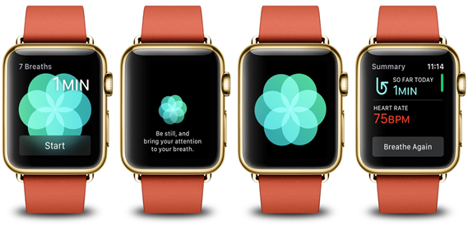
APPS TO HELP WITH ANXIETY/STRESS
Head Space App
CALM App
CALM Harm (for self-harm thoughts)
Breathe App
Slumber App
Happify App

Slide 9
CRISIS HOTLINES Help is available 24/7
Georgia Crisis & Access Line: 1-800-715-4225
National Crisis Line: 1-800-273-TALK (1-800-273-8255)
Suicide Prevention Hotline: 1-800-SUICIDE (1-800-784-2433)
Text line: text HELLO to 741741
National Domestic Violence Hotline: 1-800-799-7233 and TTY 1-800-787-3224
Georgia – Report Child Abuse: DFCS 1-855-422-4453
Disaster Distress Helpline: 1-800-985-5990 Text: TalkWithUs to 66746 TTY 1-800-846-8517

Slide 10
Guidelines for COVID-19
Every one of us play a critical role in helping to slow the spread of COVID-19 (Coronavirus) by following the guidance of the Georgia Department of Public Health:
Practice social distancing by putting 6 feet between yourself and other people and don’t be in groups of more than 10 people.
Avoid close contact with people who are sick.
Stay home if you are sick.
Wash your hands frequently with soap and water.
Use alcohol-based hand sanitizer if soap and water are not available.
Cover your cough or sneeze.
Avoid touching your eyes, nose and mouth with unwashed hands.
Stay Safe!

