Slide 1
9th Grade Counseling Lesson

Slide 2
Who is your school counselor?
A- Da- Mrs. Lea Ponticelli, Department Chair
De-I- Mrs. Misty Hawk
J- Ni- Ms. Crystal Jordan
No-Ro, Ms. Annie Soltis
Ru-Z, and all Dual Enrollment-
Dr. Tammy White

Slide 3
Reasons to see your counselor
ACADEMIC
SOCIAL/EMOTIONAL
CAREER
To make an appointment with your counselor visit the Counseling Office

Slide 5
Linktree

Slide 6
Things to Know
Safety
Harassment & bullying policy
Tell an adult (teacher, counselor, assistant principal) if you’re being harassed/bullied or know of others
Crisis
A life-threatening situation
Tell an adult immediately
Confidentiality
Limits of confidentiality

Slide 7
Essential Question
What do you need to know to be successful in 9th grade and beyond?

Slide 8
Let’s talk about…
GPA
Course Rigor
Transcripts
Promotion Requirements
Graduation Requirements
Dual Enrollment
Your Responsibilities in the Classroom

Slide 9
What is GPA?
Grade Point Average (GPA):
A = 4.0 90-100
B = 3.0 80-89
C = 2.0 74-79
D = 1.0 70-73
F = 0.0 69 and ↓
Different kinds of GPA
Weighted vs. Unweighted
Cumulative vs. Core
HOPE
College
Notes:
Talking points: Cumulative – includes all classes taken in high school and quality points for honors and AP/IB; Core – includes classes taken in English, math, science, social studies, and foreign language and quality points for honors and AP/IB; HOPE – includes classes taken in English, math, science, social studies, and foreign language and quality points (.5) for AP/IB if you made below an A; College – varies from school to school (students should check with individual schools)
Refer to brochure on HOPE GPA. Make copies of the included PDF brochure or order brochures for free from Georgia Student Finance Commission at:
https://www.gsfc.org/gheac/order_loan/index.cfm?guid=&returnurl=https%3a%2f%2fsecure.gacollege411.org%2fHome%2fEducator.aspx

Slide 10
How do I calculate a GPA?
Step 1: Assign each grade a numeric value
A=4 (90-100%)
B=3 (80-89%)
C=2 (74-79%)
D=1 (70-73%)
F=0 (0-69%)
Step 2: Add the numeric point value
Step 3: Divide by the total number of credits attempted
AP and honors courses earn quality points
AP = +1 quality point
Honors = +0.5 quality point
Notes:
Explain how to calculate the GPA
Use this opportunity to discuss quality points and how they are added.
Refer to Board rule for which courses receive quality points.

Slide 11
GPA Examples
Example 1
Algebra I - B = 3.0
World Geography – A=4.0
Intro to Drafting – B = 3.0
Art – B = 3.0
3.0 + 4.0+ 3.0+ 3.0= 13
13/4 = 3.25 GPA
Example 2
H Algebra – C = 2.5
H World Geography – B = 3.5
Intro to Drafting – B = 3.0
Art – A = 4.0
2.5 + 3.5+ 3.0 +4.0= 13
13/4 = 3.25 GPA
Notes:
Can use this or make up your own examples. May want to ask a student to come to the whiteboard and assist you.

Slide 12
Why take Honors and AP classes?
Provides opportunities to improve study skills
Familiarizes you with college level work
Can boost your cumulative GPA
Prepares you for big tests (ACT, SAT, ASVAB, Accuplacer, Milestones)
Gives you an advantage in college admissions
Allows you to expand your interests
May be eligible for college credit (AP Exam)
Improves work ethic and critical thinking skills for workforce
BUT… you must find the right balance for YOU; don’t compare yourself to others
Notes:
May want to discuss different colleges and the Freshman Student Profile for UGA and GA Tech vs. other colleges if you are discussing in state. Let them know how many AP classes they are looking for.

Slide 13
Report Card versus Transcript?
Report Card
Transcript
Grades from one semester
Unofficial document
Used by parent or guardian
Includes some personal information (address, Cobb ID)
Record of all high school final grades
Official legal document
Used by colleges, military, and employers
Includes identifying personal information (SS#, DOB, address)
Includes cumulative GPA
Notes:
Report Cards are now on studentVUE and parentVUE at the end of the semester. It is no longer handed out.
You can discuss that you get a transcript at the beginning of every semester and what you need to do to get a copy of your transcript at other times.

Slide 14
How Many Credits Do I need for Graduation?
Area of Study | Required Credits
English/Language Arts | 4 credits
Mathematics | 4 credits
Science | 4 credits
Social Studies | 3 credits
World Language/Technical/Fine Art | 3 credits
Personal Fitness | 0.5 credit
Health | 0.5 credit
Electives | 4 credits
TOTAL CREDITS: | 23
Notes:
Refer to handout of graduation requirements
Refer to Administrative Rule IKE for detailed promotion requirements

Slide 15
Promotion Requirements
Grade Level | Required Credits
10th | 5 credits (1 credit each in core English, Math and Science)
11th | 10 credits (2 credits each in core English, Math, and Science)
12th | 16 credits

Slide 16
Four Year Course Plan
Write name
This is just a projection of the next 3 years
You will register for 10th grade courses at a later date

Slide 17
English Language Arts
4 credits required for graduation
9th Lit, American Lit, and two additional lit credits
End of Course test in and American Lit
Please circle the course you are taking this school year
Think about what course you would like to take in 10th, 11th, and 12th grade.
Circle a course for 10th, 11th and 12th grade

Slide 18
Math
4 Credits required for graduation
End of Course test in Algebra I
4-year colleges typically require a credit higher than Algebra II
Please circle the course you are taking this school year
Think about what course you would like to take in 10th, 11th, and 12th grade.
Circle a course for 10th, 11th and 12th grade

Slide 19
Science
4 credits required for graduation
1 Biology, 1 Chemistry/Environmental Science, 1 Physics, 1 Science Elective
End of Course test in Biology
There are many science electives such as Zoology, Forensic Science, Honors Human Anatomy and many AP courses.
Please circle the course you are taking this school year
Think about what course you would like to take in 10th, 11th, and 12th grade.
Circle a course for 10th, 11th and 12th grade

Slide 20
Social Studies
3 Credits required for graduation
World History, US History, Government and Economics
End of Course test in US History
World Geography is considered academic electives
Academic electives offered:
Psychology
Sociology
AP Human Geography
AP Psychology

Slide 21
Social Studies 3 Credits required for graduation World History, US History, Government and Economics
Please circle the course you are taking this school year
Think about what course you would like to take in 10th, 11th, and 12th grade.
Circle a course for 10th, 11th and 12th grade

Slide 22
World Languages
Spanish and French
Graduation requirement – 3 total credits in Foreign Language, Career Tech or Fine Arts
4-year colleges require at least 2 credits of the same Language -Helps you to communicate and connect with other cultures.
- Quality Points:
a) .5 quality point for Honors Level 3
b) 1.0 quality point for Honors Level 4 and above
-Counts towards the HOPE Scholarship GPA

Slide 23
World Languages and Electives Graduation requirement – 3 total credits in Foreign Language, Career Tech or Fine Arts
Spanish
SpanishII
Please write the World Language course or elective you are taking this school year
Think about what course you would like to take in 10th, 11th, and 12th grade.
Write down your elective thoughts for 10th, 11th and 12th grade – please remember this is not registration

Slide 24
Dual Enrollment (DE)
DE is a state funded program that allows 11th and 12th graders to take college classes while completing their high school diploma.
DE also provides limited options for 10th graders
Any 10th grader can take CTAE classes at a Technical College
10th graders who have earned a 1200 SAT or 26 ACT (in one sitting) are eligible to apply to any DE program
DE pays for 100% tuition, mandatory fees, and required textbooks up to a maximum cap of 30 hours (this equates to roughly one year of full-time college enrollment or around 10 courses)

Slide 25
Tips for Success in High School
Basic Requirements
Going Above and Beyond
Come to school
Be on time
Have your materials
Pay attention
Complete and submit your assignments
Find out what you missed when absent and make up work in a timely manner
Check your grades
Review & preview notes
Attend tutoring
Communicate with your teachers
Take detailed notes
Study nightly
Keep a calendar
Stay organized

Slide 26
Naviance Tasks to complete in Naviance
Naviance is a delivery system and college/career search engine. We use it to communicate with you and we will use it throughout the year for various activities.
You can access Naviance from the CCSD homepage, your school’s website, as well as your school counseling department’s website.
Update email address
Complete AchieveWorks Personality Assessment
Complete 9th Bridge Survey

Slide 27
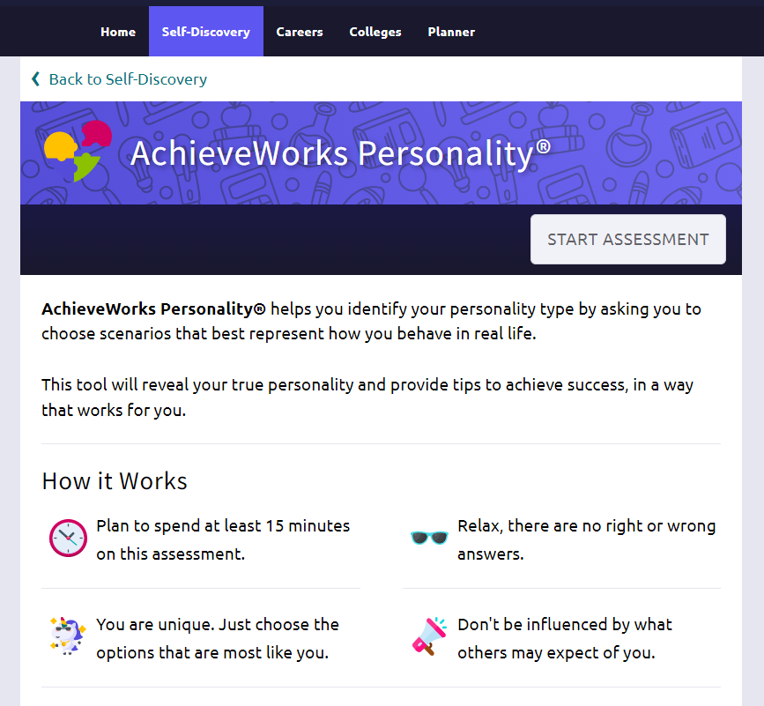
Career Interest Profiler Assessment

Slide 28
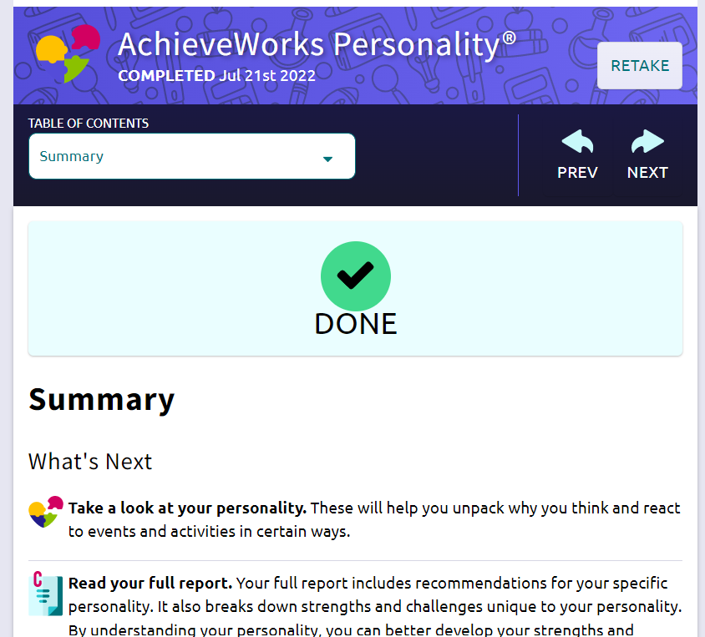
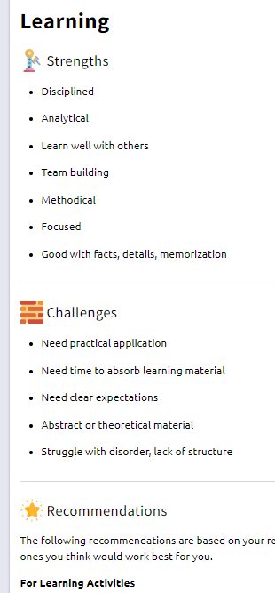
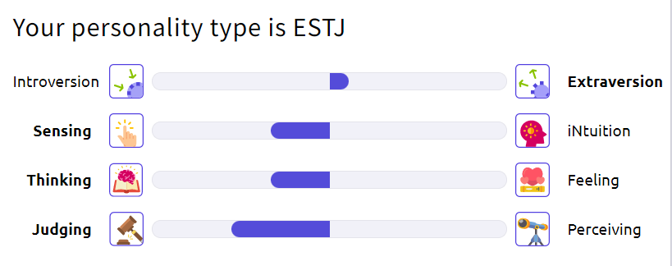
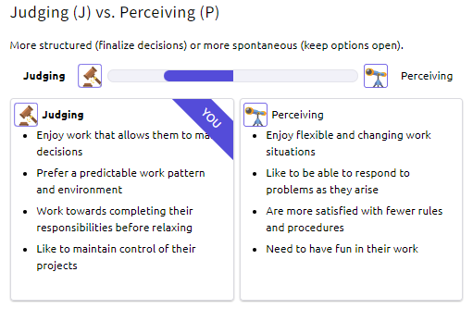
Review results related to your personality

Slide 29
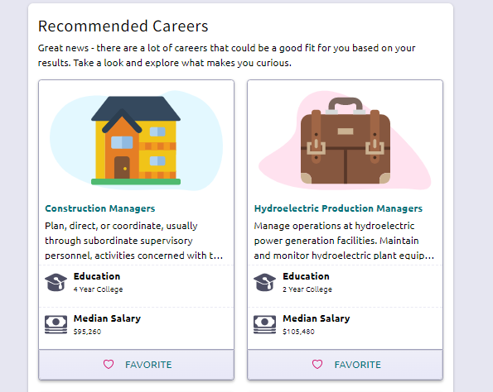
Explore Careers
You will add top 3 career interests in the BRIDGE survey

Slide 30
9th Bridge Survey

Slide 31
www.cobbk12.org
Go to WWW.Cobbk12.org
Click on “FIND IT FAST”
Click on “NAVIANCE”
Continue with CLEVER

Slide 32
Logging into Naviance
Go to www.cobbk12.org
User Name: | Password:
Microsoft 365 User Name | Microsoft 365 Password
Go to “Find it Fast”
Go to “Naviance”
Continue with CLEVER

Slide 33
Adding STUDENT E-MAIL ADDRESS
Click on “About Me”
Choose “My Account”
Click the Pencil Icon/Edit under “Contact”
Scroll & enter student email address **This is the email that you use the most.
Press Save

Slide 34
Tasks to Complete
Scroll down to Important To-Dos and Tasks
Complete AcheiveWorks Personality
After completing the AchieveWorks Personality Assessment click Home on the top banner
Complete 9th Bridge Survey

Slide 35
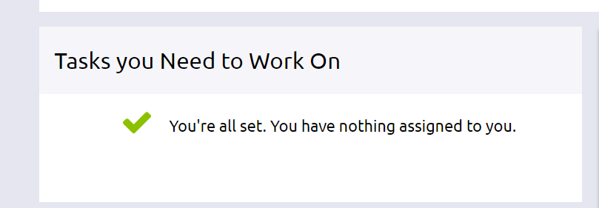
Don’t log out!
Make sure a counselor has verified all Tasks have been completed
Click “My Planner”
Choose “Tasks”
You will see a message when finished

